Slide 1

第5章
售中沟通与服务

Slide 2
目 录
5.1
收到订单催促付款的沟通
5.5
关联产品推介
5.2
买方付款后的其他情况处理
5.6
发货前的特殊订单处理
5.3
货物途中可能遇到的情况处理
5.7
特定情况下包裹延误的处理
5.4
货运相关进展情况处理

Slide 3
5.6
发货前的特殊订单处理

Slide 4

课程内容
01
合并支付及修改价格
02
海关收税咨询
由于物流风险，无法向买家所在国家发货
03
04
订单超重导致无法使用小包包邮
05
没有直航货机

Slide 5
01
合并支付及修改价格

Slide 6

合并支付及修改价格
同一个买家在同一天下的两笔不同订单，收件地址一样，这样的订单就可以合并支付，并且还可以合并成一个包裹发出去。但卖家应该跟买家沟通好，同时可以给买家一点价格优惠以增强买家的购物体验。

Slide 7
合并支付及修改价格
Dear customer,
If you would like to place one order for many items, please first click "add to cart", then "buy now", and check your address and order details carefully before clicking "submit". After that, please inform me, and I will cut down the price to US$ XX. You can refresh the page to continue your payment. Thank you.
If you have any further questions, please feel free to contact me.
Best regard
(Your name)

Slide 8
02
海关收税咨询

Slide 9

海关收税咨询
有时候客户会担心在货物到达海关后需要支付额外费用。此时应该如实向客户进行解释，必要时需要引导客户向当地海关咨询，不能欺骗客户购买。

Slide 10
海关收税咨询
Dear customer,
Thanks for your inquiry and I am happy to contact you.
I understand that you are worried about any possible extra cost for this item. Based on past experience, import taxes falls into two situations.
First, in most countries, it did not involve any extra expense on the buyer side for similar small or low-cost items.
Second, in some individual cases, buyers might need to pay some import taxes or customs charges even when their purchase is small. As to specific rates, please consult your local customs office.
If you have any questions, please let us know.
Best regard
(Your name)

Slide 11
03
由于物流风险，无法向买家所在国家发货

Slide 12
由于物流风险，无法向买家所在国家发货
针对一些特殊国家(如国家发生战争等)，物流暂时无法向买方所在国家发货，此时也需要跟买方及时沟通。征求买家的意见，是否可以寄往其他国家或地区。
Dear customer,
I am sorry to inform you that our store is not able to provide shipping service to your country. However, if you plan to ship your orders to other countries, please let us know. Hope we can accommodate future orders.
I appreciate for your understanding.
Best regard
(Your name)

Slide 13
04
订单超重导致无法使用小包包邮

Slide 14
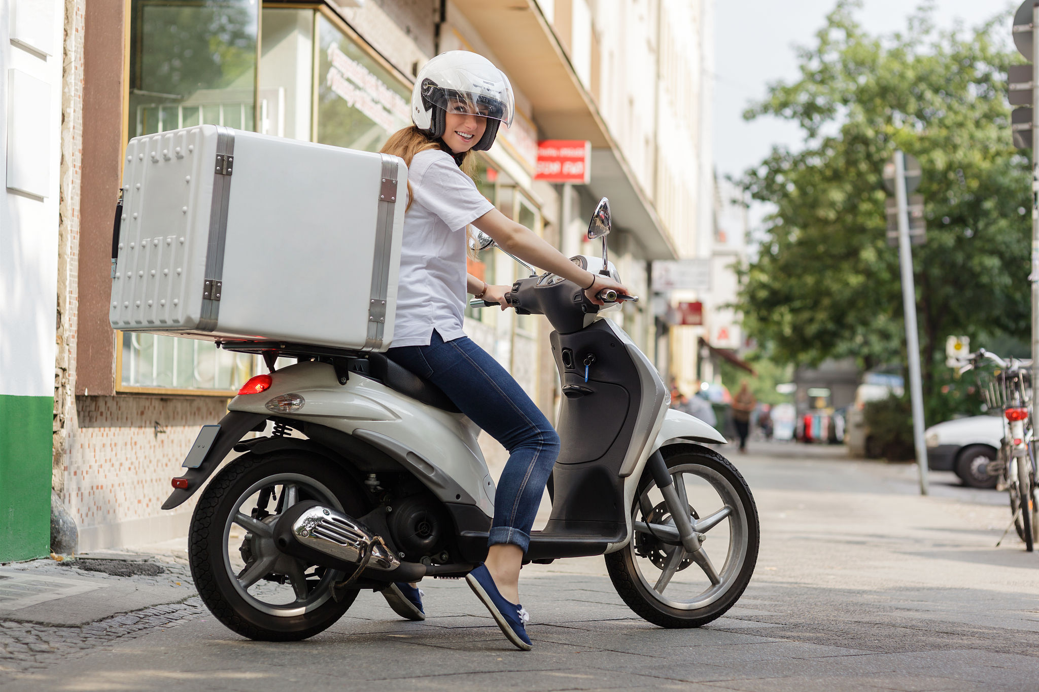
订单超重导致无法使用小包包邮
小包包邮是卖家经常使用的促销手段之一。但是在有些情况下，买家一次性购买了多种货物，导致订单超过2kg，无法使用小包包邮。此时，可以建议买家使用其他快递方式，或者将一个订单拆分成若干个小于2kg的多个订单。

Slide 15
订单超重导致无法使用小包包邮
Dear customer,
I am sorry to tell you that the free shipping for this item is unavailable. I’m really sorry for the confusion.
Free shipping is only for package weighing less than 2 KG, which can be shipped via China Post Air Mail. However, the item you would like to purchase weighs more than 2 KG. You can either choose another express carrier, such as UPS or DHL (which will include shipping fees, but are much faster)
Or you can place the orders separately, making sure each order weighs less than 2 KG, to take advantage of free shipping.
If you any questions, please let us know.
Best regard
(Your name)

Slide 16
05
没有直航货机

Slide 17

没有直航货机
针对一些没有直航货机的客户，卖家应向买家说明由于没有直飞航班，所有去该国的包裹都要通过其他国家中转，所以在运输时间上很难控制，让买家对收货时间有个心理预期。

Slide 18
没有直航货机
Dear customer,
We can send this item to Lithuania. However, there's only one problem.
Due to there are little direct cargo flight between Lithuania and China, the items shipped to there has to be transited from other Europe Countries.
That make the shipping time is hard to control.
As our former experience, normally it will take 25 to 45 days to arrive at your country.
Is it OK for you?
Waiting for your reply.
Best regard
(Your name)

Slide 19
谢谢大家

