Slide 1

第5章
售中沟通与服务

Slide 2
目 录
5.1
收到订单催促付款的沟通
5.5
关联产品推介
5.2
买方付款后的其他情况处理
5.6
发货前的特殊订单处理
5.3
货物途中可能遇到的情况处理
5.7
特定情况下包裹延误的处理
5.4
货运相关进展情况处理

Slide 3
5.5
关联产品推介

Slide 4

课程内容
01
推荐关联产品
02
推荐订阅店铺
03
推荐特殊产品

Slide 5
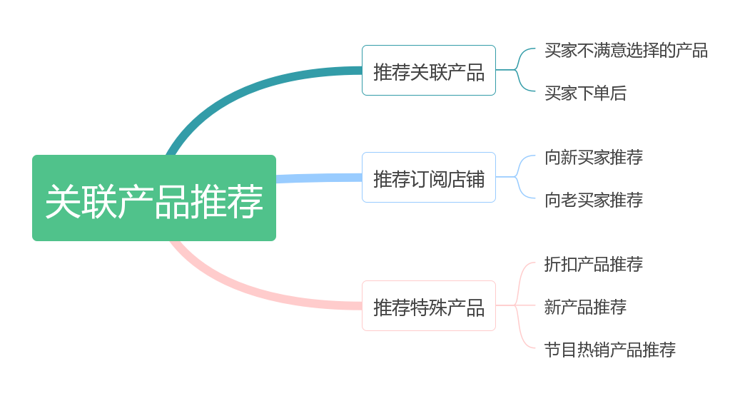
关联产品推介
客服的关联产品推荐服务如图所示

Slide 6
01
推荐关联产品

Slide 7


推荐关联产品
1.买家不满意选择的产品，可以推荐关联产品
如果买家在询问之后发现其感兴趣的产品有某些地方不如意，此时卖家可以把关联的产品推荐给他，告诉他这些是相关的热销商品，希望他能够喜欢。

Slide 8
推荐关联产品
1.买家不满意选择的产品，可以推荐关联产品
Dear customer,
I am sorry that your are not satisfied with the product you inquired.According to your information, I would like to recommend some other items of similar styles and hope you will like them too. These are our popular best selling right now. Please click the link ***************and ************** to get more specific information about the items.
If you have any question about the item, please feel free to contact us.
Best regard
(Your name)

Slide 9

推荐关联产品
2.买家下单后，推荐产品的关联产品
如果买家下单后，卖家还可以抓住机会，继续推荐与其订单相关联的产品，刺激其继续下单。

Slide 10
推荐关联产品
2.买家下单后，推荐产品的关联产品
Dear customer,
Thank you for ordering our dress. The packet has been shipped today and you will get it in about 15 days.
We are selling a popular and nice belt which coordinates your dress order. For the specific information you can click：**************.
If you have any question about the item, please feel free to contact us.
Best regard
(Your name)

Slide 11
02
推荐订阅店铺

Slide 12
推荐订阅店铺
1.向新买家推荐
向新买家推荐店铺时，主要强调的是店铺可以向客户推送最新的产品及促销信息。
Dear customer,
Thanks you for showing interest in my products. In order to offer a better service and keep you updated with the latest promotions and products, please subscribe to my store. Any problem of subscribing, please refer to http://help. amazon. com/alert subscribe. html
Best regard
(Your name)

Slide 13
推荐订阅店铺
2.向老买家推荐
向老买家推荐店铺时，主要强调的是订阅后可以享受VIP服务以及积分折扣。
Dear customer,
Welcome to subscribe to my store. By a few clicks you can enjoy our VIP service such as the latest updates from new arrivals to best selling products on a weekly basis etc. As you are our old friend, you can enjoy our discount and marks accumulation after you subscribe to our store. Any problem of subscribing please refer to http: //help. amazon. com/alert subscribe. html
Best regard
(Your name)

Slide 14
03
推荐特殊产品

Slide 15
推荐特殊产品
1.折扣产品推荐
为了刺激销售，店铺会不定期举办一些活动。在店铺活动期间，可以主动向客户推荐促销产品，告知活动信息，以刺激销售。
Dear customer,
Thanks for your message. If you buy both of the XXXX items, we can offer you a XXX% discount.
Once we confirm your payment, we will ship out the items for you in time.
Please feel free to contact us if you have any further questions.
Best regard
(Your name)

Slide 16
推荐特殊产品
2.新产品推荐
新产品上线时往往关注度不高，因为客户都不知道产品的存在，此时需要主动向买家推荐新产品的信息，以提高新产品的客流量及转化率。
Dear customer,
As Christmas and the New Year is coming. we found XXXX has a large potential market. Many customers are buying them for resale on eBay or in their retail stores because of its high profit margin. We have a large stock of XXXX. Please click the following link to check them out ************, Thanks.
Best regard
(Your name)

Slide 17

推荐特殊产品
3.节日热销产品推荐
一般来说，节日前的一段时间也是销售旺季。卖家应主动提前告知客户活动信息，及相关节日产品的信息。同时告知如果购买数量达到一定量以上，即可享受批发价格。

Slide 18
推荐特殊产品
3.节日热销产品推荐
Dear customer,
Right now Christmas/Thanksgiving/... is coming, and Christmas/Thanksgiving/... gift has a large potential market. Many buyers bought them for resale in their own store. It's a high profit margin product. Here is our Christmas/Thanksgiving/. gift link***** *********. Please click to check them. If you are going to buy more than 10 pieces in one order, you can enjoy a wholesale price of XXX. Thanks.
Best regard
(Your name)

Slide 19
谢谢大家

