Slide 1

第6章
售后沟通与服务

Slide 2
目 录
6.1
催促评价的方法
6.5
纠纷开启时的处理方法
修改评价及收到好评的沟通方法
6.2
6.6
纠纷升级为平台纠纷的处理方法
6.3
纠纷处理总流程
6.7
客户维护的方法
6.4
纠纷开始前的处理方法

Slide 3
6.7
客户维护的方法

Slide 4

课程内容
01
客户日常维护
02
推广宣传

Slide 5

客户维护的方法
与客户的感情交流是卖家用来维系客户关系的重要方式，节日的真诚问候、婚庆喜事、过生日时的一句真诚祝福、一个小礼物，都会使客户深为感动。
交易的结束并不意味着客户关系的结束，在售后还须与客户保持联系，以确保他们的满足持续下去。

Slide 6
01
客户日常维护

Slide 7

客户日常维护
1.建交函（新客户建立业务关系）
在维护客户中，试图和新客户建立业务往来关系也是极其重要的环节。在这环节中，新客户的建立需要向客户介绍公司及产品优势，希望客户能对公司的资质和产品特色所吸引。

Slide 8
客户日常维护
1.建交函（新客户建立业务关系）
Dear customer,
We'd like to introduce our company and products to you, and hope that we may build business cooperation in the future.
We are specializing in manufacturing and exporting ball pens for more than 6 years. We have profuse designs with series quality grade and our price is competitive because we are the manufacturer.
You are welcome to visit our store http://......which includes our company profiles and some hot selling products. Should any of these items be of interest to you, please let us know. As a very active manufacturer, we develop new designs every month. If you have interest in it, it's my pleasure to offer news to you regularly.
Best Regards
(your name)

Slide 9

客户日常维护
2.祝贺信
祝贺信是为了祝贺生意上的朋友高升或得奖而发出的信。虽然祝贺信是写给个人的，却和一般朋友间的通信大不一样。它会影响你今后业务的开展，使彼此间可能形成一种微妙的亲密关系。

Slide 10
客户日常维护
2.祝贺信
Dear Mr. Smith,
Congratulations on your recent promotion to Deputy Managing Director of ABC Trading Company. Because of our close association with you over the past ten years, we know how well you are qualified for this important office. You earned the promotion through years of hard work and we are delighted to see your true ability win recognition.
Congratulations and best wishes for continued success.
Sincerely
Blank Lee
Import manager

Slide 11


客户日常维护
3.节日问候
给已经联系的客户或者新开发的客户，发节日祝福邮件，一是维护好客户关系，二是和客户沟通确认细节，推荐产品，让客户记住你，对你有印象。

Slide 12
客户日常维护
3.节日问候
Dear customer,
Merry Christmas and happy New Year! The Christmas and New Year holiday is coming near once again. We would like to extend our warm wishes for the upcoming holiday season and would like to wish you and your family a Merry Christmas and a prosperous New Year. May your New Year be filled with special moment, warmth, peace and happiness, the joy of covered ones near, and wishing you all the joys of Christmas and a year of happiness.
It's my honor to contact with you before, and my duty is to give you our best products and excellent service. Hope the next year is a prosperous and harvest year for both of us Last but not least, once you have any inquiry about ***** (products ) in the following days, hope you could feel free to contact with us, which is much appreciated.
Sincerely
(your name)

Slide 13
客户日常维护
3.节日问候
Dear xxx,
Many thanks for your contiguous supports in the past years. We wish both business snowballing in the coming years.
May your New Year be filled with special moment, warmth, peace and happiness, the joy of covered ones near, and wishing you all the joys of Christmas and a year of happiness.
Last but not least, once you have any inquiry about products in the following days, hope you could feel free to contact with us, which is much appreciated.
Sincerely
(your name)

Slide 14
客户日常维护
3.节日问候
Dear xx，
As Easter Day is approaching, I do like to cherish this opportunity to wish you Happy Easter Day and brilliant life.
Regarding the xx product we talked before, the unit price is xx and packed in polybags. 10 pieces is put in one carton 20X25X30cm And the carton weight is 5 KG. The delivery time is 10-15 days. Is this information correct and enough?
Happy Easter and enjoy your life. We are always ready to offer you best service if you kindly let me know.
Sincerely
(your name)

Slide 15


客户日常维护
4.问候老客户
问候可以加深客户对之前有过购物经历的店铺的印象。
非节假日问候老客户的主要目的是向客户介绍店铺的最新优惠活动，或者向客户介绍公司的最新产品。除了这两个目的，单纯性的问候也必不可少，以免客户遗忘店铺。

Slide 16
客户日常维护
4.问候老客户
Dear xxx,
It has been a long time we did not make contact. How are you doing?
Would you please kindly let us know what kind of the product you are looking for recently? If you have any new inquiry, please let us know and we would quote you our best price.
Attached is the updated price lists for your reference. Thanks for your attention.
Sincerely
(Your name)

Slide 17
02
推广宣传

Slide 18

推广宣传
1.推荐订阅店铺
产品邮件推送功能是速卖通平台为买家和卖家双方搭建起来的一个沟通渠道。买家一经订阅，每周都可以收到平台最新的优质产品和优质店铺信息，以及买家通过关键词或行业订阅的相关信息。卖家可以利用这个功能，推荐买家订阅卖家的店铺，即可让买家在第一时间了解卖家的最新产品。

Slide 19

推广宣传
Sample 1
Dear buyer,
Thanks you for showing interest in my products. In order to offer a better service and keep you updated with the latest promotions and products, please subscribe to my store. Any problem of subscribing, please refer to help. aliexpress. com/alert subscribe. html
Sincerely
(your name)

Slide 20

推广宣传
Sample 2
Dear buyer,
Welcome to subscribe to my store. By a few clicks you can enjoy our VIP service such as the latest updates from new arrivals to best-selling products on a weekly basis etc. Any problem of subscribing, please refer to help aliexpress. com/alert subscribe. html
Sincerely
(your name)

Slide 21

推广宣传
2.营销活动推荐
营销推广的手段无非有以下几种：优惠券、限时秒杀、打折促销、会员优惠、抽奖活动等。
这些活动都可以在一定程度上促进网站订单量的提升，那么，这些推广活动的开展除了吸引新客户以外，还有就是为了让店铺的老客户能再次进行购买，增加老客户的回头购买率。

Slide 22
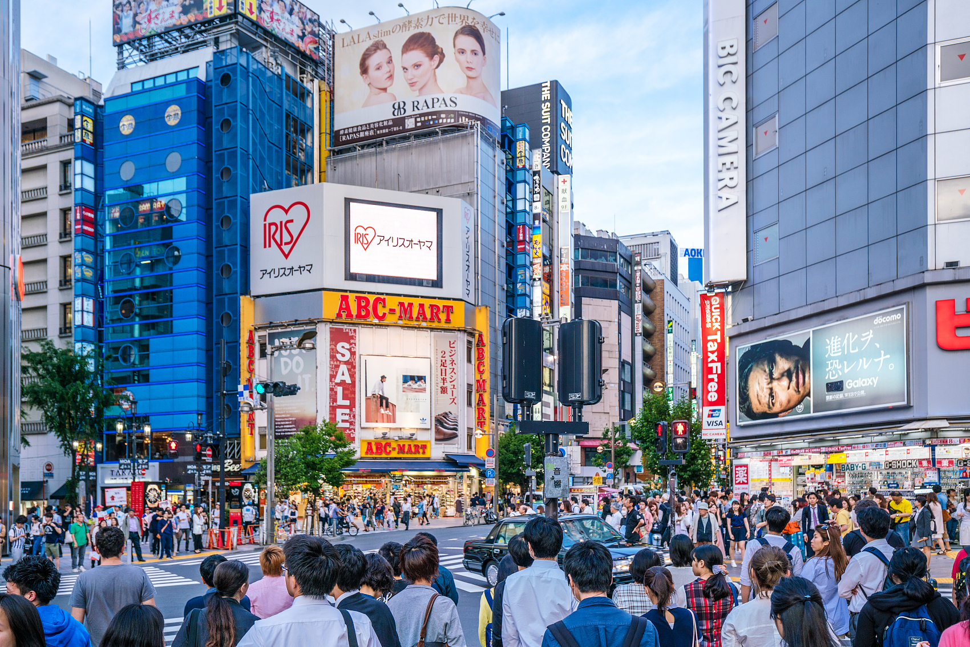

推广宣传
Sample 1
Dear buyer,
Right now Christmas is coming, and Christmas gift has a large potential market. Many buyers bought them for resale in their own stores, and it's high profit margin product. Here is our Christmas gift link, please click to check them. If you want to buy more than 10 pieces, we can also help you get a wholesale price. Thanks.
Regards
(your name)

Slide 23

推广宣传
Sample 2
Dear buyer,
Thank you for shopping in my shop.
To express our gratefulness to all our customers, a series of promotional activities will be held from June 1st to 7th by your company, such as $15 off orders of $99 or more, 22% off for all the products and different coupons for your choice. There are only 7 days left for the activities.
Don't hesitate to visit us.
Regards
(your name)

Slide 24
谢谢大家

