Slide 1

第6章
售后沟通与服务

Slide 2
目 录
6.1
催促评价的方法
6.5
纠纷开启时的处理方法
修改评价及收到好评的沟通方法
6.2
6.6
纠纷升级为平台纠纷的处理方法
6.3
纠纷处理总流程
6.7
客户维护的方法
6.4
纠纷开始前的处理方法

Slide 3
6.5
纠纷开启时的处理方法

Slide 4

课程内容
01
货不对版启纠纷
02
货物未在规定时间内到货
03
产品质量问题启纠纷

Slide 5
01
货不对版启纠纷

Slide 6

货不对版启纠纷
买家投诉货物与描述不符或者货物数量不对，这时候卖家可以请求买家根据问题类型提供相应的证据。

Slide 7
货不对版启纠纷
Sample 1
Dear Customer,
We sincerely regret that the items you've received in order XXXXX were not as described. Our goal is to resolve any dispute as quickly and conveniently as possible. Choice #1: You have claimed the items did notwork/work properly. As such, we must ask that you please make a video recording to illustrate this issue and send them directly to my email XXXXXXXX. This will allow us to verify the problem and help resolve it to your satisfaction. Choice #2: You have claimed the items did not work/work properly. As such, we must ask that you please take some photos to illustrate this issue and send them to my email: XXXXXXXX. This will allow us to verify the problem and help resolve it to your satisfaction. We apologize for the inconvenience and look forward to hearing from you.
Best Regards
(your name)

Slide 8

货不对版启纠纷
Sample 2
Dear buyer,
I am so sorry for our carelessness. I need confirm the weight of parcel to check the less quantity with our shipment staff who just start to work after some days. Could i offset the i piece's money when you order next time, and we can give you a good discount or send a simple gift to you? Or if you ask for immediate refund now, could you give me your PayPal account?
I am so sorry for all the inconvenience.
Best Regards
(your name)

Slide 9



货不对版启纠纷
买家投诉货物与描述不符或者货物数量不对，这时候卖家可以请求买家根据问题类型提供相应的证据。

Slide 10
货不对版启纠纷
Dear buyer,
We sincerely regret that you are not satisfied with your purchase. We accept returns or exchanges as long as the item is unopened and/or unused. We strive to provide exceptional products and service to our customers and your opinion is very important to us. Please provide a detailed explanation, photos are also welcome. Please send your item back to: xx, xxxx, 325000, Wenzhou, China
We will send you a replacement upon receipt of your parcel. Please be aware that the return shipping and any new shipping charges for a replacement item will be charged to the buyer.
If you have any other concerns, please contact us through eBay message so that we can respond you promptly, thanks!
Best Regards
(your name)

Slide 11
货不对版启纠纷
当买家收到货物不满意并提出退货时，我们该如何应对呢？
Hello, seller, I don't like the goods you send to me, can I return?
当然，我们是允许退货的，因此可以回复:
Dear buyer,
Yes, we accept return or exchange. Please send your item back to: xx, xxxx, 325000, Wenzhou, China
We will refund (excluding the postage) you via Pay Pal once I receive your parcel.
Best Regards
(your name)

Slide 12
货不对版启纠纷
客户要求换货：
Hello, seller, I don' t like the goods you send to me, can I barter?
如果我们能接受换货，但是客户需要承担物流费用，以减轻我们的成本。
Dear buyer,
Sure, you can send it back for exchange. Please send your item back to: xx, xxxx, 325000, Wenzhou, China
We will send you a new one after receiving you parcel. Please be aware that you must bear the cost of return shipping and re-send shipping.
Thanks for your understanding and any other questions feel free to let me know.
Best Regards
(your name)

Slide 13
02
货物未在规定时间内到货

Slide 14
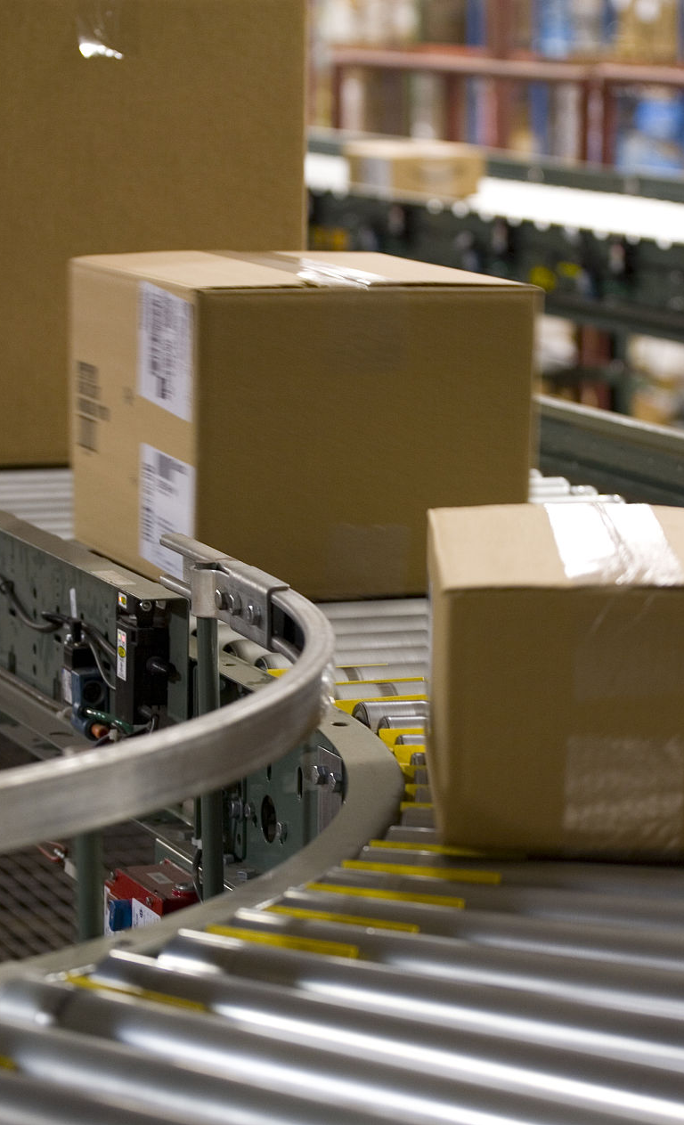

货物未在规定时间内到货
货物由于一些原因仍在途中超过了规定时间未到货，或者货物丢失，这些都会引起买家开启纠纷。开启纠纷后，卖家要及时和买家沟通，可通过退款或重新发货来处理纠纷问题。

Slide 15
货物未在规定时间内到货
Sample 1
Dear Customer
We sincerely regret that you haven't received your package. We have looked into this matter, and can share the following information about your order(No XXXXX): Tracking No: XXXXXXX Status: XXXXXXX Shipped Date: XXXXXXX Standard shipping times are approximately 7-15business days, however with increased holiday demand there may be a delay in international delivery times. We promise a full refund including original shipping charge if the item is not delivered in XXXX days after receipt of payment. Your satisfaction is our utmost priority; please contact us if you have any concerns. We apologize for the inconvenience. Your under standing is greatly appreciated.
Best regards
(your name)

Slide 16
货物未在规定时间内到货
Sample 2
Dear Customer,
We sincerely regret that you haven’t received your parcel yet. We can confirm that we sent your order on January 10, 2014; however, we were informed by the shipping company that the package has been delayed due to problems on their end. We can arrange reshipment or a full refund to you. Please let us know what is your preferred option and we'll resolve this matter as quickly as possible. We apologize for the inconvenience. Your understanding is greatly appreciated.
Best Regards
(your name)

Slide 17
货物未在规定时间内到货
Sample 3
Dear Customer,
We would like to confirm that we sent your order on January 10, 2014however, we were informed the package has not yet arrived due to shipping delays at the shipping company. According to our agreement, we have resent your order by EMS, with a new tracking number of: XXX. It typically takes 7-10 business days to arrive to your destination. We apologize for the inconvenience and thank you for your patience.
Best Regards
(your name)

Slide 18

货物未在规定时间内到货
买家的留言：
Hello, seller, I haven't received the product that you sent to me.
这时我们该怎么进行回复呢？
将物流信息和物流单号告诉客户，或者对节假日等可预测的邮递延误进行解释，也或者对天气等不可抗力因素造成的延误进行解释。

Slide 19
货物未在规定时间内到货
（1）物品未收到的问题
Dear Customer,
Thank you for purchasing (item ID or item title). We have sent the package out on Dec16. The postal tracking number is below for your reference:No. RR725377313CN
Status: departure from outward office of exchange
Ship-out Date: 2017-1-10
Standard ship times are approximately 7-15 business days. However, there may be delay in international parcel delivery times due to increased holiday demand. We promise a full refund including original shipping charge if the item is not delivered within 30 days upon receipt of payment. Your satisfaction is our utmost priority, please contact us if you have any concerns. We apologize for any inconvenience. Your understanding is greatly appreciated.
Best regards
(your name)

Slide 20
货物未在规定时间内到货
（2）对节假日等可预测的邮递延误进行解释
Dear Customer,
Thank you for your purchase and prompt payment. China will celebrate National Holiday from October 1st through October 7th. During that time, all the shipping services will be unavailable and may cause the shipping delay for several days.
We will promptly ship your item when the post office re-opens on October 8th. If you have any concerns, please contact us through eBay message.
Thank you for your understanding and your patience is much appreciated.
Best regards
(your name)

Slide 21
货物未在规定时间内到货
（3）对天气等不可抗力因素造成的延误进行解释
Dear Customer,
Thank you for purchasing an item from our store. We are sorry to inform of you that the delivery of your item may be delayed due to Hurricane Sandy.
We shipped your item(white cotton T-shirt) on Dec. 3rd but unfortunately, we were notified by the post off ice that all parcels will be delayed due to this natural disaster.
Your patience is much appreciated If you have any concerns, please contact us through eBay message so that we can respond promptly. Our thoughts are with you.
Best regards
(your name)

Slide 22
03
产品质量问题启纠纷

Slide 23


产品质量问题启纠纷
买家因为产品质量问题开启纠纷，此时卖家要积极与买家协商解决问题，要双方达成一致地解决意见。

Slide 24
产品质量问题启纠纷
Sample 1
Dear friend,
We are sorry for the quality problems and would pay more attention to the product quality check in the future.
We will accept your requirement and please kindly return the goods to the following address: xxxxxxxx
However, some friends will accept the second plan that we send you anew one with 90% discount and you cancel the dispute without paying for the highly returning shipping fee. Hope you consider it.
Thank you!
Best regards
(your name)

Slide 25
产品质量问题启纠纷
Sample 2
Dear friend,
The photos were received with thanks. Sorry that we failed to check out the problem and we would pay more attention to this part.
Anyway we will refund you $3 for compensating or may you just accept this time and we would like to provide bigger discount for your next order?
Sorry again for the trouble. Please feel free to let us have your comment.
Thanks!
Best regards
(your name)

Slide 26
产品质量问题启纠纷
当买家收到货，发觉质量有问题。
Hello, seller, I have received the goods you send to me, but I found that it is with a bad quality.
如果不是产品质量有问题，卖家首先要表明质量不是由我方造成的，而是由于物流不当造成质量问题，以便能得到客户的原谅，但是最好能够允诺下次的购物优惠，让客户能更好地接受。

Slide 27
产品质量问题启纠纷
卖家可以按照如下模板回复：
Dear friend ,
I am very sorry to hear about that. Since I did carefully check the order and the package to make sure everything was in good condition before shipping it out, I suppose that the damage might have happened during the transportation. But I'm still very sorry for the inconvenience this has brought you. I guarantee that I will give you more discounts to make this up next time you buy from us. Thanks for your understanding.
Best regards
(your name)

Slide 28
谢谢大家

