Slide 1

第5章
售中沟通与服务

Slide 2
目 录
5.1
收到订单催促付款的沟通
5.5
关联产品推介
5.2
买方付款后的其他情况处理
5.6
发货前的特殊订单处理
5.3
货物途中可能遇到的情况处理
5.7
特定情况下包裹延误的处理
5.4
货运相关进展情况处理

Slide 3
5.1
收到订单催促付款的沟通

Slide 4
01
催促付款

Slide 5
催促付款
1.提醒买家付款（通用）
一般情况下，客户下单后没有及时付款，可以提醒客户若有产品的价格、尺寸等相关问题，可以及时告知，还可以提醒客户付款后会尽快发货。
Dear customer,
We have got your order of ***. But it seems that the order is still unpaid. If there's anything I can help with the price, size, etc. please feel free to contact me.
Once the payment is confirmed, I will process the order and ship it out as soon as possible.
Thanks!
Best regards
(Your name)

Slide 6






催促付款
2.针对无等级买家，客人可能不会付款
此模板用于客户是新手的情况，可能客户不太熟悉付款流程。此时应该向客户介绍具体的付款流程，同时告知客户如果还有疑问可尽快联系。

Slide 7
催促付款
2.针对无等级买家，客人可能不会付款
Dear customer,
We appreciated your purchase from us. But we noticed that you haven't payment yet. You may not know how to pay.
This is a detailed payment process links: ********
If you have any questions about payment, or any other reason that you don't want to go to complete the order, please let us know.
We can help you solve the question of payment or make any changes the order.
Thanks again! We are all looking forward to get your answer as soon as possible.
Best regards,
(Your name)

Slide 8


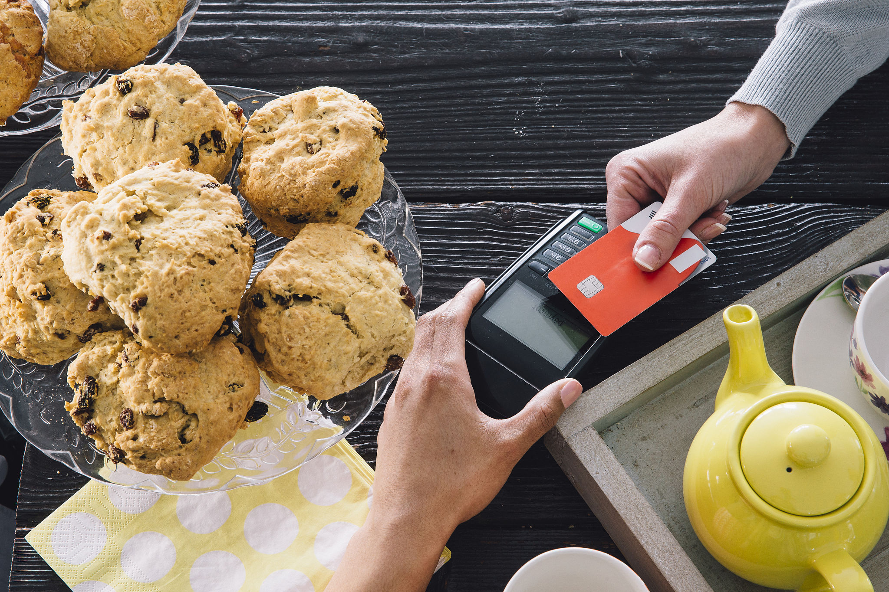
催促付款
3.针对客户下单后半天未付款的情况
客户拍下产品半天内还没有付款，有可能还处于对产品的犹豫期。此时应该用1~2句话概括产品的特点，以强化客户对产品的信心。
如：可以说明产品high quality with competitive price，也可以说产品 popular，同时还可以提示Instant payment。但注意不要过分强调，以免客户反感。

Slide 9

催促付款
3.针对客户下单后半天未付款的情况
Dear Customer,
Thanks for your order.
The item you selected is a one with high quality/a most fashion /most popular one with competitive price. You would like it.
Since they are very popular, the product may sell out soon. Instant payment can ensure earlier arrangement to avoid short of stock.
Thank you and awaiting your payment.
Best Regards,
(Your name)

Slide 10
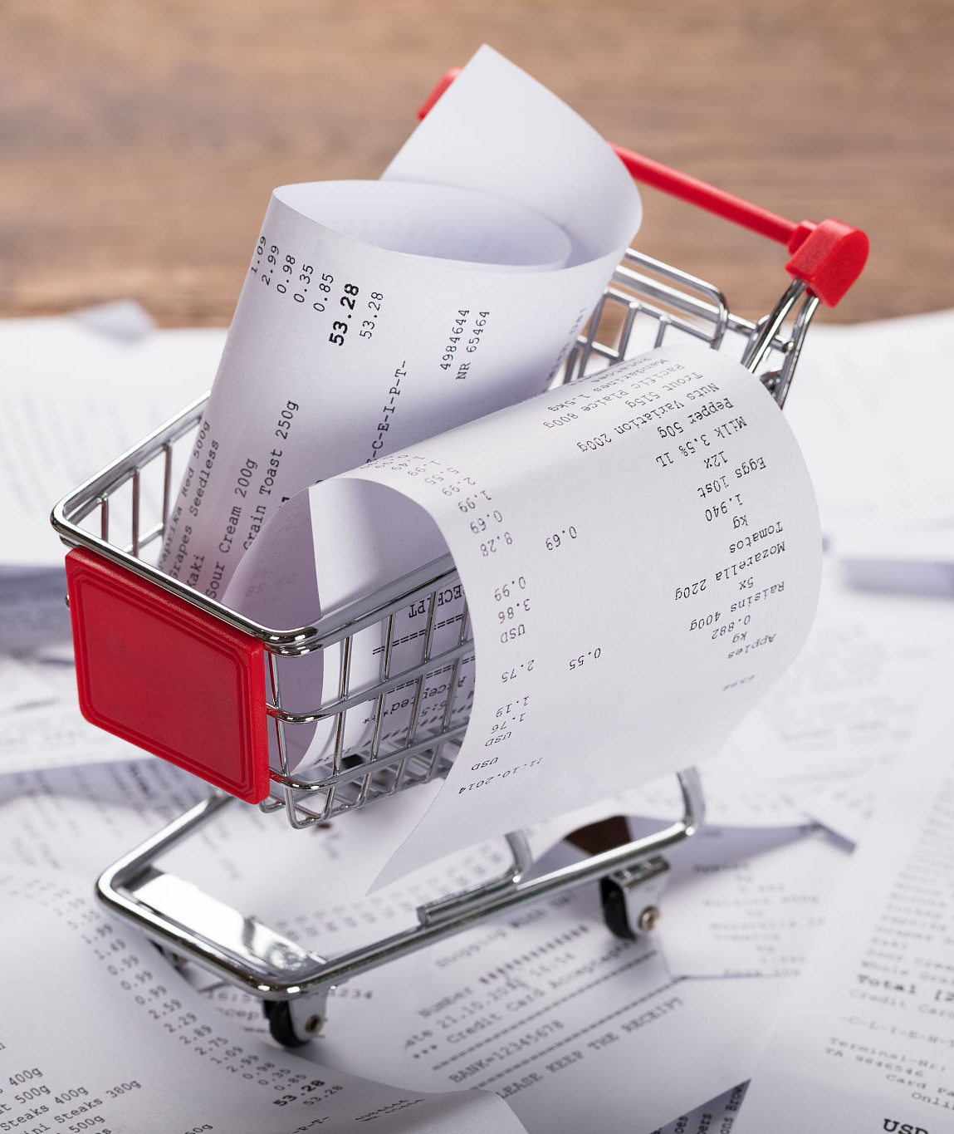
催促付款
4.针对客户下单后2天未付款的情况
若客户下单后2天内还未付款，且之前发送的邮件也没有回复，则有可能是客户觉得价格高了或者找到了更便宜的卖家。此时可以告知客户产品利润很薄，但是愿意给予一定的折扣以促成交易。

Slide 11

催促付款
4.针对客户下单后2天未付款的情况
Dear friend,
We found you haven't paid for the order you placed several days ago. The payment process has already been sent to you and I think you have already known how to pay.
Our profit margin for this product is very limited. But if you think the price is too high, we can give you a discount of 3%. Hope you are happy with it and you are welcome to contact me if there's anything else I can help with.
Best Regards,
(Your name)
若客户下单后2天还没有付款，且发送的2封邮件也没有回复，则可以放弃该客户。

Slide 12

催促付款
5.提醒客户库存不多，请尽快付款
如果在活动期间订单量较大，为避免断货导致客户不能购买到其想要的产品，可以提醒客户产品库存不多，请尽快付款，否则有可能会断货。

Slide 13
催促付款
5.提醒客户库存不多，请尽快付款
Dear friend,
Thank you for your inquiry.
You have chosen one of the best-selling products in our store. It is very popular for its good quality and competitive price. We have only 10 pieces of blue T-shirt left now. We would like to inform you that this product may be sold out soon.
We noticed that you hadn't finished the payment process for the order. To ensure that the product wont be sold out, we will ship your order within 24 hours once your payment is confirmed. If you need any help or have any questions, please let us know.
Best regards,
(Your name)

Slide 14
催促付款
6.提醒折扣/活动快要结束
如果促销活动快要结束，买家下订单后迟迟没有付款，卖家可以提醒买家早日付款以免错过折扣/活动。
Dear friend,
Thank you for the message. Please note that there are only 3 days left to get 10% off by making payments with Escow(credit card, Visa, Master Card, money book or Western Union). Please make the payment as soon as possible. I will also send you an additional gift to show our appreciation.
Please let me know for any further questions. Thanks.
Best regards
(Your name)

Slide 15
催促付款
7.由于回复不及时错过客户的咨询
周末或者节假日有可能导致回复不够及时，可以先表示歉意，因为错过了最佳的24小时回复时间，所以卖家也可以通过主动打折的方式来贏取客户。
Dear friend,
I am sorry for the delayed response due to the weekend(or holiday). We do have this item in stock And to show our apology for the delayed response, we will offer you 10% off. Please make the payment before Friday to enjoy this discount. Thank you.
Please let me know if you have any further questions.
Best regards,
(Your name)

Slide 16
谢谢大家

